Slide 1
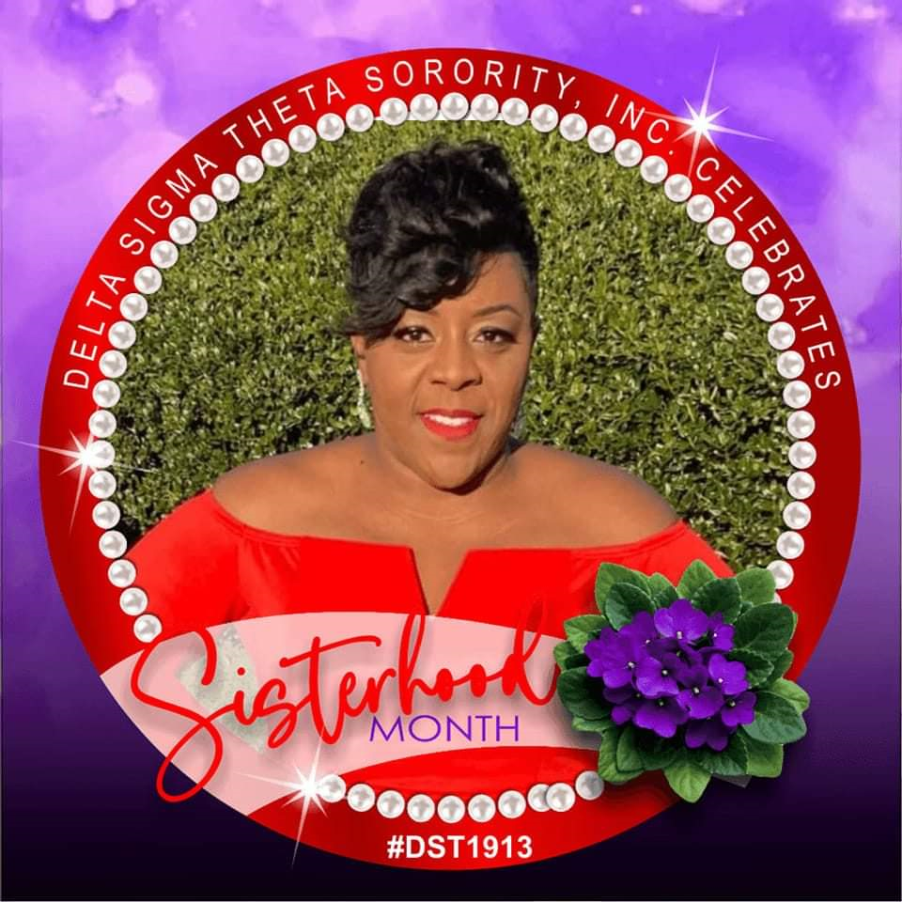
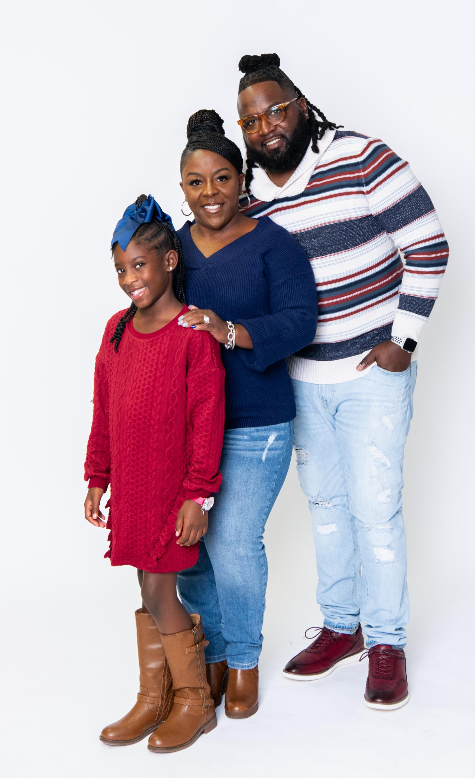
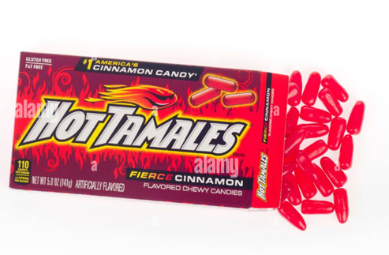
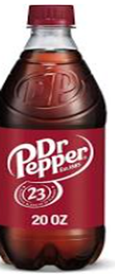
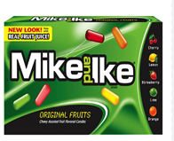
About Mrs. Gault
Timeline To Teaching
I was born and raised in Augusta Ga., and still currently live here.
I am a PROUD Educator of RCBOE of 17 years!
I completed my Master's degree in Education at the Ashford University.
Began teaching at A.D. Hines 2023- present
Mrs. Gault
My Favorite Things
Food: Seafood, Mexican
Drink: Dr. Pepper, Coffee
Color: Red and White
Candy: Mike & Ike’s Hot Tamales
Hobby: Watching Sports, Shopping
Place to Visit: Beach or Mountains
Collectable: Wonder Woman Items
About Me
A
I am married with 1 daughter. I love working with others and establishing a positive environment. I strive for UNITY and Fairness. I believe it is important to treat others the way you want to be treated. Respect is earned and we should always take responsibility for our actions. I strongly feel it is ok to be with the crowd, but always have a mind of your own.

